Slide 1
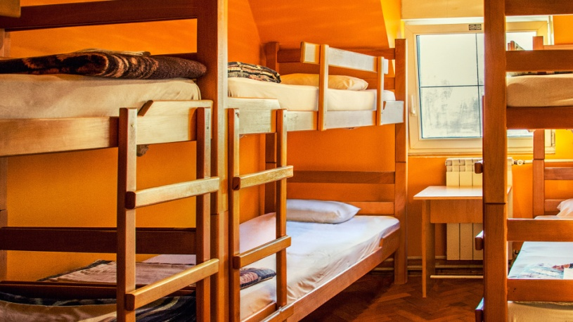
HOSTEL BASED MANAGEMENT SYSTEM
TEAM MEMBERS
SHUBHRANIL MAJI
SHUVAM PRAKASH
SIDDHARTH SINGH
SOMANNA PD

Slide 2
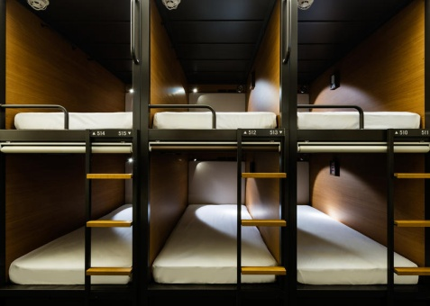
INTRODUCTION
The Hostel Based Management System’s main purpose is to computerize the storage of data for student and staff.
This system will be developed to form an efficient management system to incorporate the general information, details, fee structure and a complaint section for the students.
It will also include a management system for the staff details and their salary according to their experience and specialization.

Slide 3
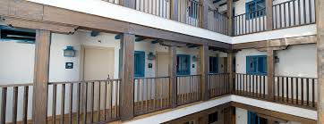
OBJECTIVES
The current system is one of paper and pen where human error is possible.
Our objective is to replace this system so the administrator can insert, delete and modify the student and the staff details as per the requirements.
Computation of student fee and the staff salary can be easily maintained in this system.
This project will help to simplify the process of hostel administration.

Slide 4
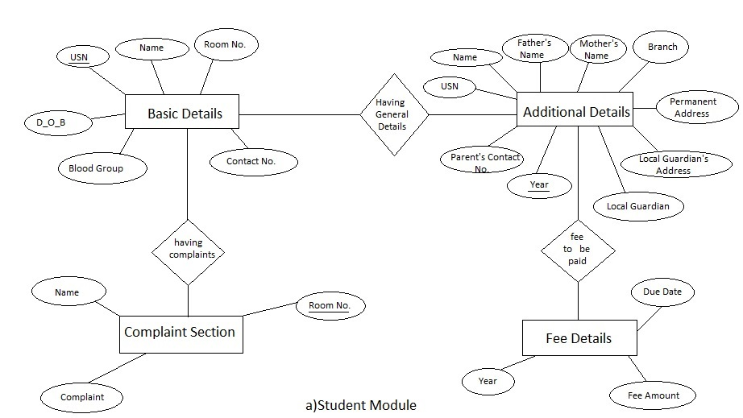
SCHEMA (ENTITY RELATIONSHIP DIAGRAM)

Slide 5
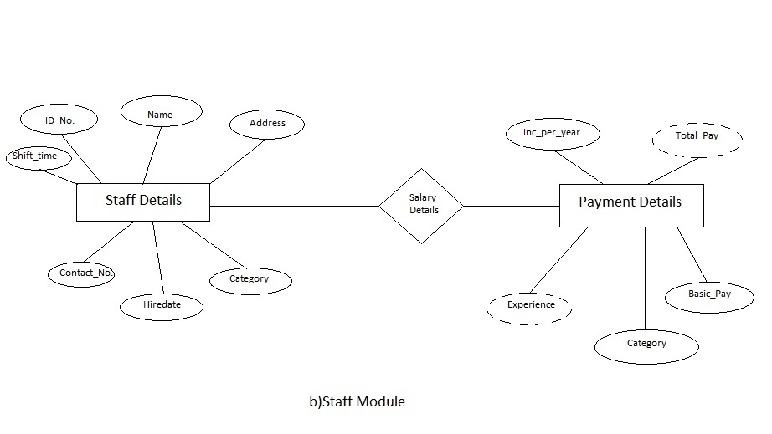
SCHEMA (ENTITY RELATIONSHIP DIAGRAM)

Slide 6
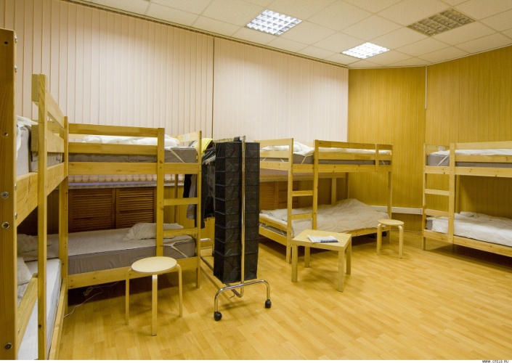
BRIEF DESCRIPTION
STUDENT MODULE
General Information
This module will provide a quick view of a particular student.
Additional Information
This module will provide the additional details
of the student
Fee Structure
This module will contain the fee details of each year.
Complaint Section
This table will have the specific purpose of recording the student complaints regarding their stay.

Slide 7
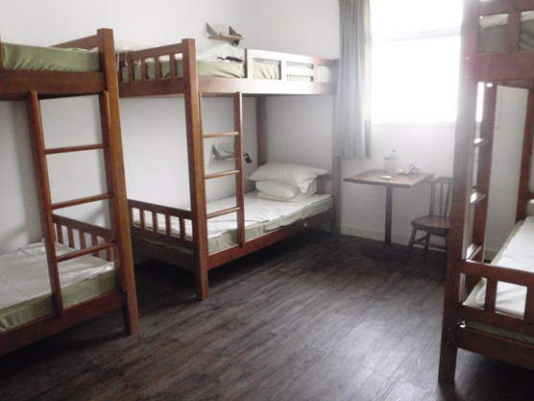
BRIEF DESCRIPTION
STAFF MODULE
General Information
This module will give an info about the category and details of a particular staff member. It will also include their shift timings.
Salary Structure
This module will be designed to compute
the salary of the staff members
according to their category and
experience.

Slide 8
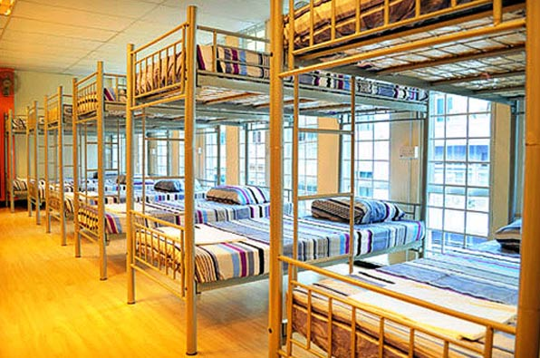
SYSTEM REQUIREMENTS
Operating System Required :
> Microsoft Windows XP or higher
> Ubuntu 14.04
2 CPU Cores
2 GB RAM
Disk I/O subsystem applicable to a write-intensive database
RAID10 or RAID 0+1 disk setup(recommended)

Slide 9
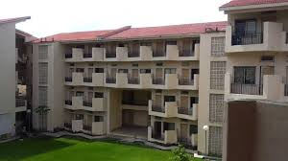
FUTURE ENHANCEMENT
This module will be designed to compute the salary of the staff members according to their category and experience.
The project will include a front end to make it more user friendly.
A user interface can be provided for the admission of students into the hostel.
Another module can be added to incorporate the details of the passed out students.
More features can be added to include the maintenance of finance of mess operations.

